Slide 1
Assignment on oops
TO
THE MENTOR
KARAN
from
pavankalyan
Lakshmi Sahgal batch

Slide 2
AGENDA OF THIS PPT
OOPS(OBJECT ORIENTED PROGRAMMING LANGUAGE)
OBJECT
CLASS
ENCAPSULATION
ABSTRACTION
INHERITANCE
POLYMORPHISM

Slide 3
Introduction of OOPs
Object-oriented programming (OOP) is a style of programming characterized by the identification of classes of objects closely linked with the methods with which they are associated.
OOP mainly focuses on the objects that are required to be manipulated instead of logic.
Advantages of oops
Troubleshooting is easier with the OOP language
Code Reusability
Code Flexibility
Solving problems
Security

Slide 4
What is class and object
Class
Collection of similar objects is called class.
class contains properties/state and behaviour/methods of an object.
Object
Object means a real-world entity such as a pen, chair, table, computer, watch, etc.
Any entity that has state and behaviour is known as an object.

Slide 5
Declaration of Class syntax:
Class class_name
{
//variable;
//methods;
}
Declaration of object syntax:
Class_name obj_name=new Class_name();

Slide 6
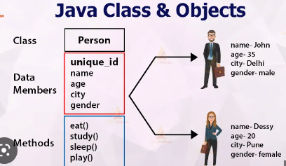
For e.g.
Car- This is class
Object is :-
Brand name
Model
Name
Car number
Behaviour is:-
Mileage()
Comfort()
Wheel drive ().

Slide 7
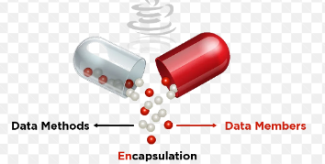
Encapsulation
Encapsulation in Java is the process by which data (variables) and the code that acts upon them (methods) are integrated as a single unit.
It is not accessible to out side of class and only these functions which is wrapped in class access it.
The insulation of the data from the direct access by the program is called data hiding

Slide 8
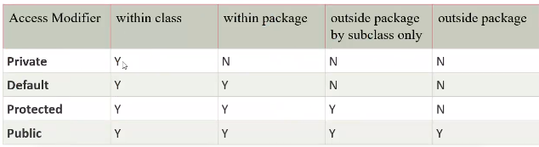
Four types of Java access modifiers
Private: The access level of a private modifier is only within the class. It cannot be accessed from outside the class.
Default: The access level of a default modifier is only within the package. It cannot be accessed from outside the package. If you do not specify any access level, it will be the default.
Protected: The access level of a protected modifier is within the package and outside the package through child class. If you do not make the child class, it cannot be accessed from outside the package.
Public: The access level of a public modifier is everywhere. It can be accessed from within the class, outside the class, within the package and outside the package

Slide 9
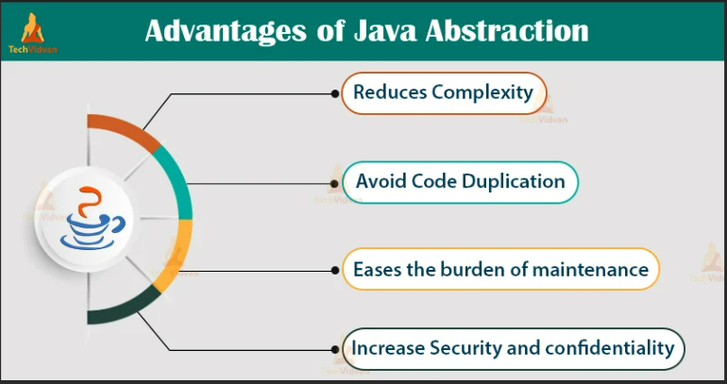
Data abstraction
The technique of creating new data type that are well suited to an application is known as data abstraction
It means we can combine data structure & operation on the data structure together into
a new abstraction data type

Slide 10
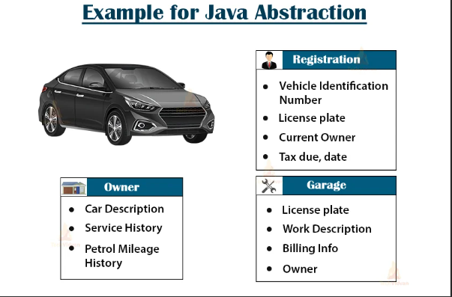
ABSTRACTION

Slide 11
INHERITANCE
Inheritance in Java is a concept that acquires the properties from one class to other classes; for example, the relationship between father and son.
Inheritance in Java is a process of acquiring all the behaviours of a parent object.
Single inheritance
Multiple inheritance
Multilevel inheritance
Hierrarchial inheritance
Hybrid inheritance

Slide 12
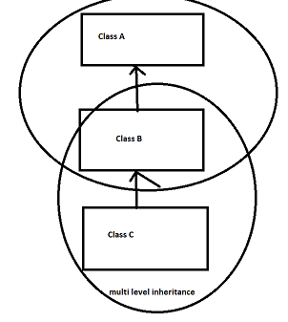
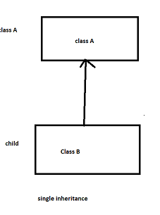
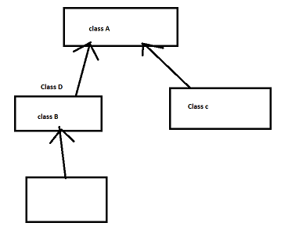
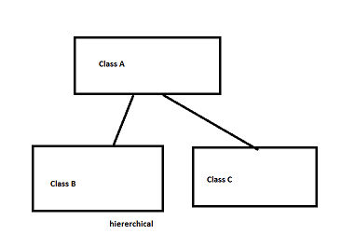
Single inheritance.
Multi-level inheritance
NOTE
JAVA DOES NOT
SUPPORT
MULTIPLE INHERITANCE
Hybrid Inheritance
Hierarchical Inheritance.

Slide 13

Polymorphism
Polymorphism means having many forms. In simple words, we can define polymorphism as the ability of a message to be displayed in more than one form or functions.
In Java polymorphism is mainly divided into two types:
Compile-time Polymorphism(Method overloading/Static binding)
Runtime Polymorphism(Method overriding/Dynamic binding)

Slide 14
Method overloading
If a class has multiple methods having same name but different in parameters, it is known as Method Overloading.
Different ways to overload the method
There are two ways to overload the method in java
By changing number of arguments
By changing the data type
In Java, Method Overloading is not possible by changing the return type of the method only.

Slide 15
Method overriding
If subclass (child class) has the same method as declared in the parent class, it is known as method overriding in Java.
Rules for Java Method Overriding
The method must have the same name as in the parent class
The method must have the same parameter as in the parent class.
There must be an IS-A relationship (inheritance).

Slide 16
THANK YOU

